Slide 1
BM project-human data

Slide 2
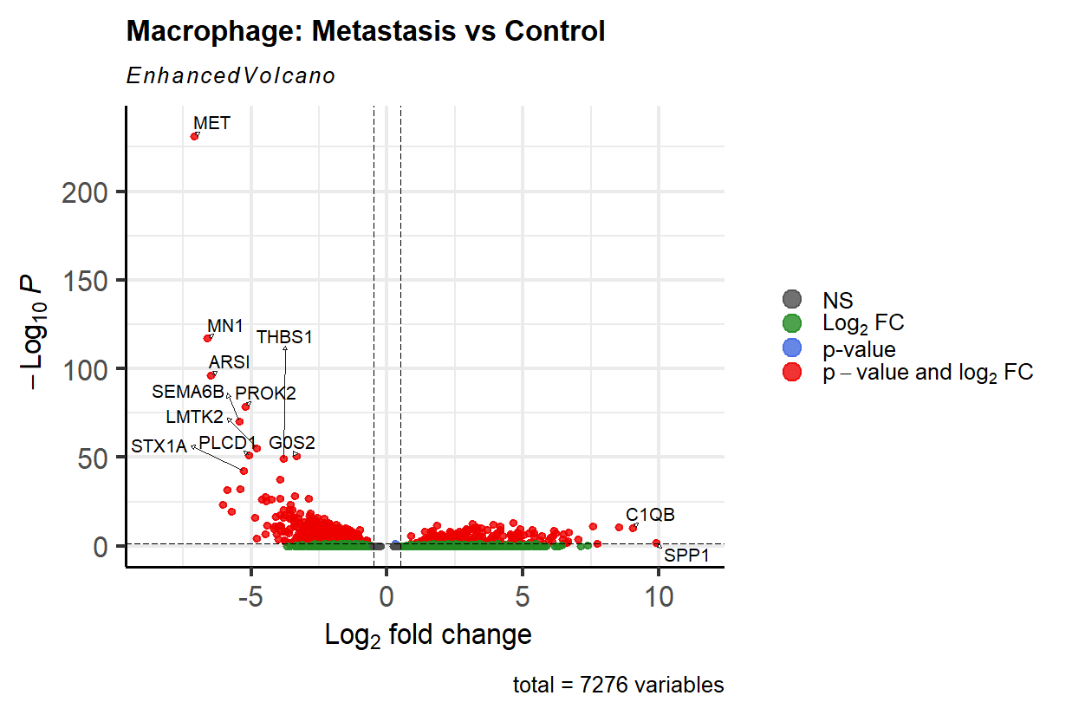
DEG of metastasis vs control, In macrophage only

Slide 3
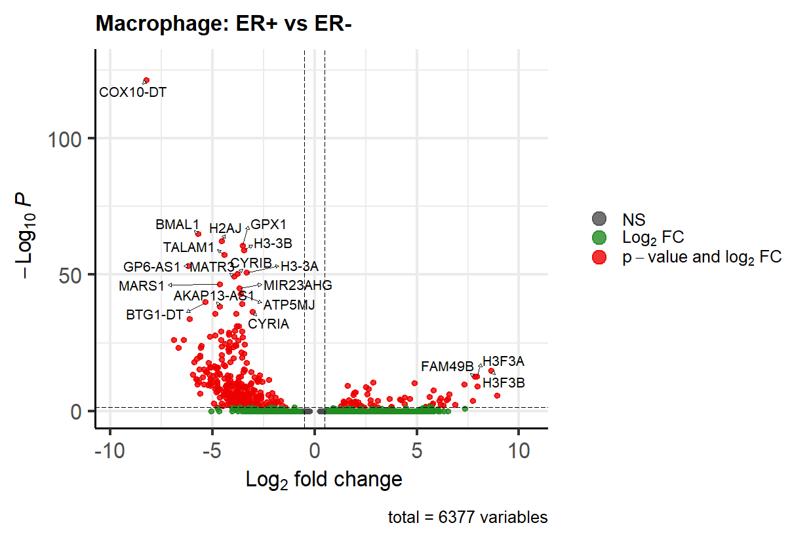
DEG of ER+ vs ER-, In macrophage only

Slide 4
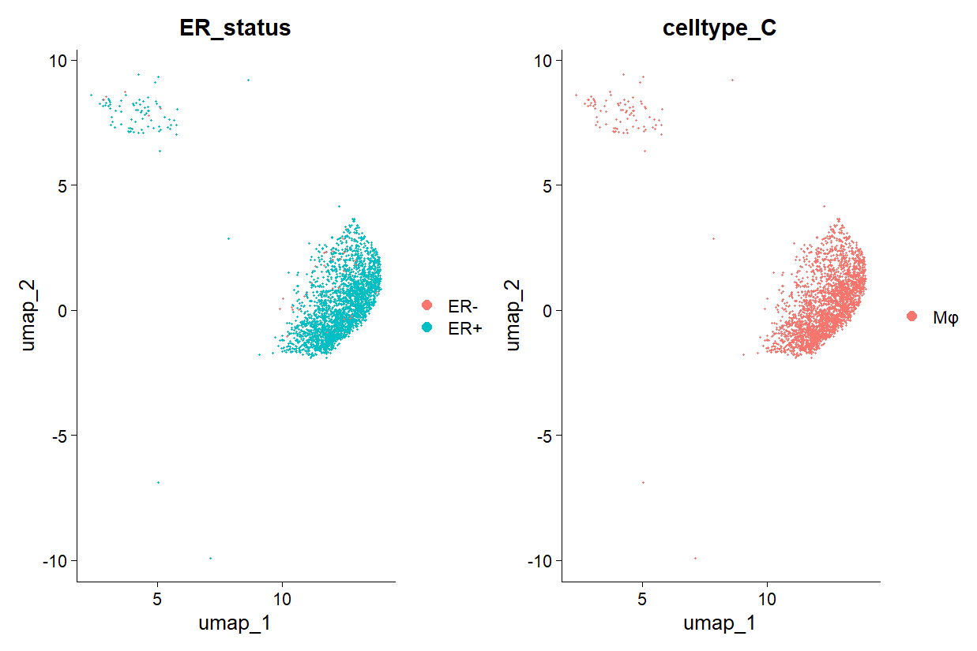
ER+/ER-

Slide 5
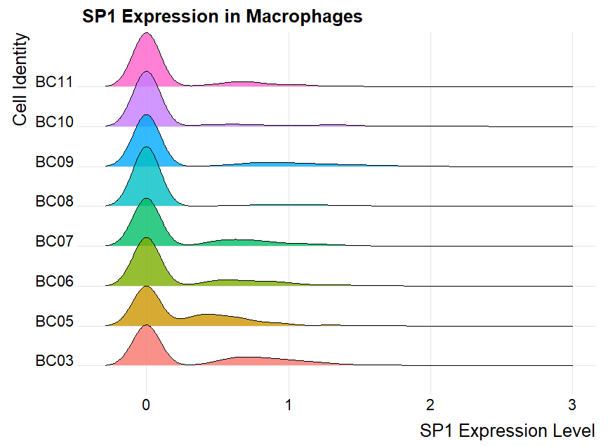
SP1 expression

Slide 6
todo
Get all macrophage from all samples, do sub-clustering
Use both standard way [high variance]
Target: find clusters to match Yuliang’s genes’pattern
Most important one is ER and SP1 that is both high
对于cancer, 找到origin：BC,TC，percentage
细分之后是否有更细的富集的cancer type
是否metasis treatment response 与某种macrophage亚群相关
Gender, tissue origin,

